Slide 1
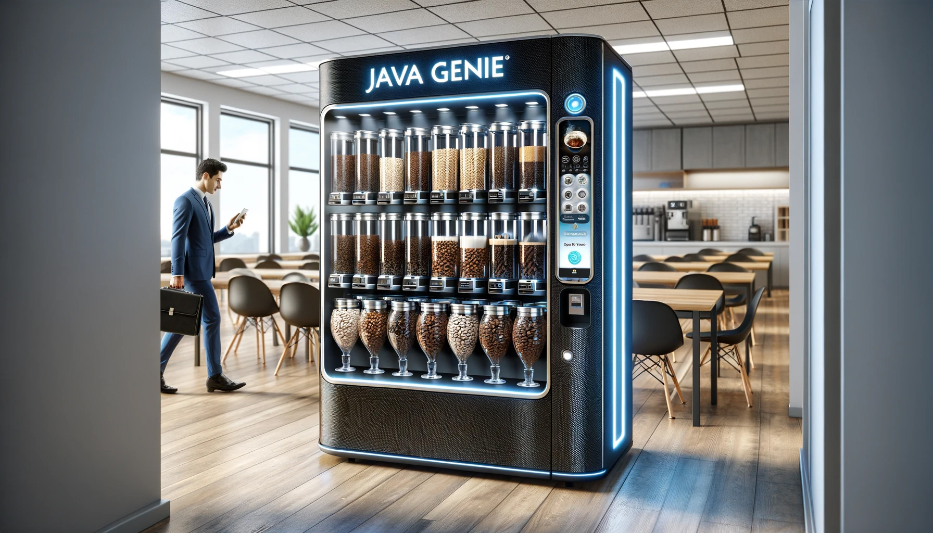
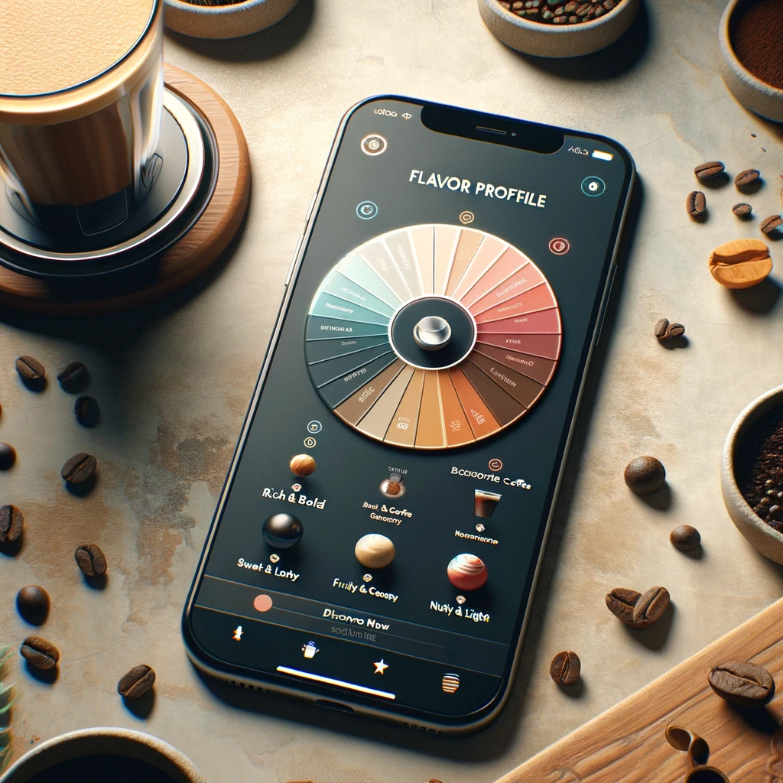

Java Genie
Apex Engineering
Your Wish Is Our Brew
TM
TM
TM

Slide 2

Coffee: America's Favorite Drink
66% of Americans drink coffee every day [1]
400 Million cups of coffee every day [2]
$80 Billion US Coffee Industry [3]
[1] National Coffee Association (NCA) https://joesgaragecoffee.com/blog/coffee-drinking-statistics/ ​
[2] Coffee Statistics https://dealsonhealth.net/coffee-statistics/ ​
[3] Statistica https://www.statista.com/topics/1248/coffee-market/#topicOverview ​

Slide 3
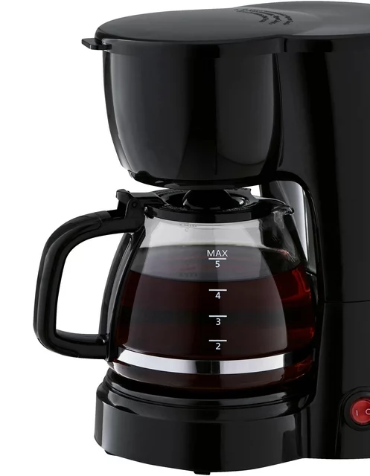
Problem
Limited access to quality coffee can lead to decreased productivity
Traditional Office Coffee is a
One-Size-Fits-All Approach
Going to cafe leads to loss of workplace efficiency and increased downtime

Slide 4
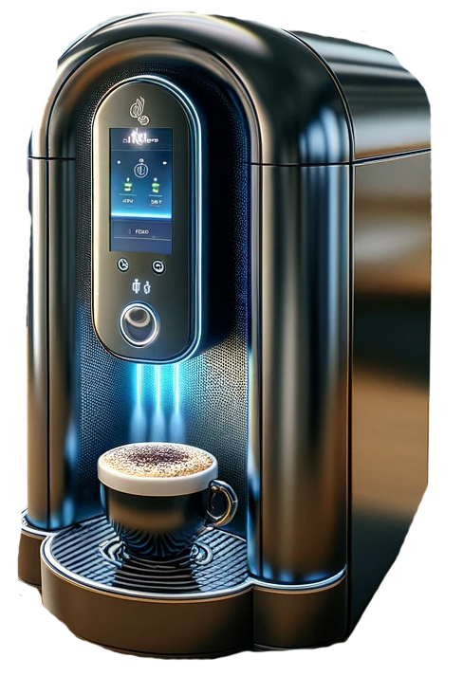
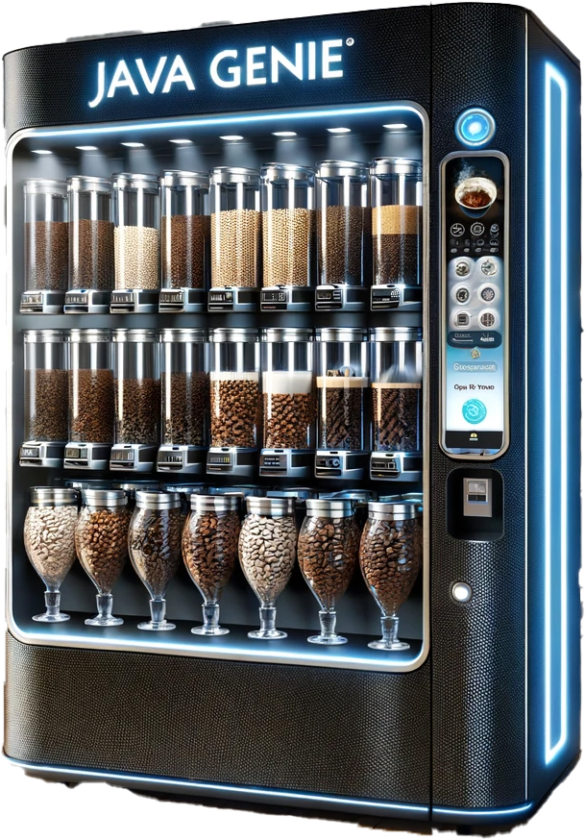
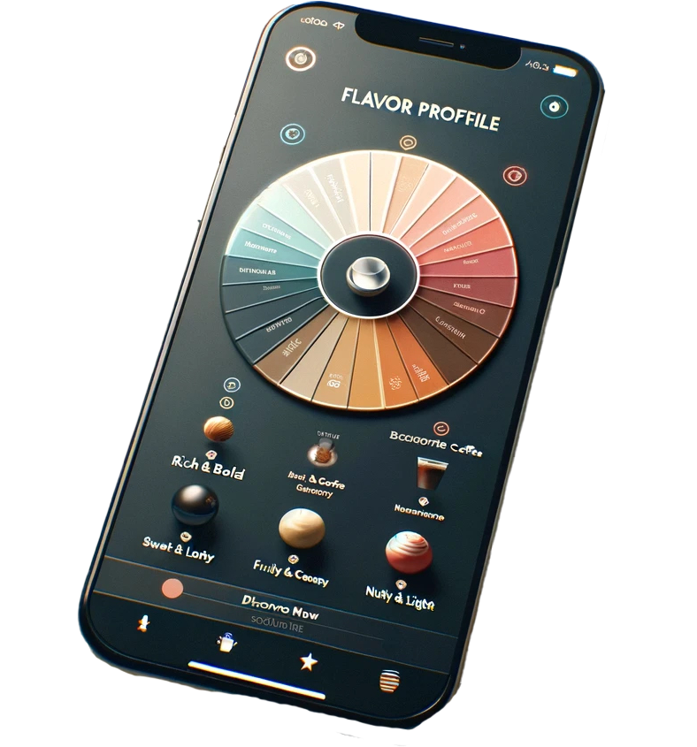

Java Genie Roadmap
Q3 2024
Q1 2025
Q1 2026
Q4 2026
Java Genie App
Coffee Rewards
& Partners Expansion
Java Genie
Vending Machine
Java Genie
Espresso Machine

Slide 5

Java Genie (2024)
AI Recommender for coffee drinks, cafes, and coffee products based on personalized flavor profiles
Integrated AI Chatbot, an expert barista in your pocket

Slide 6
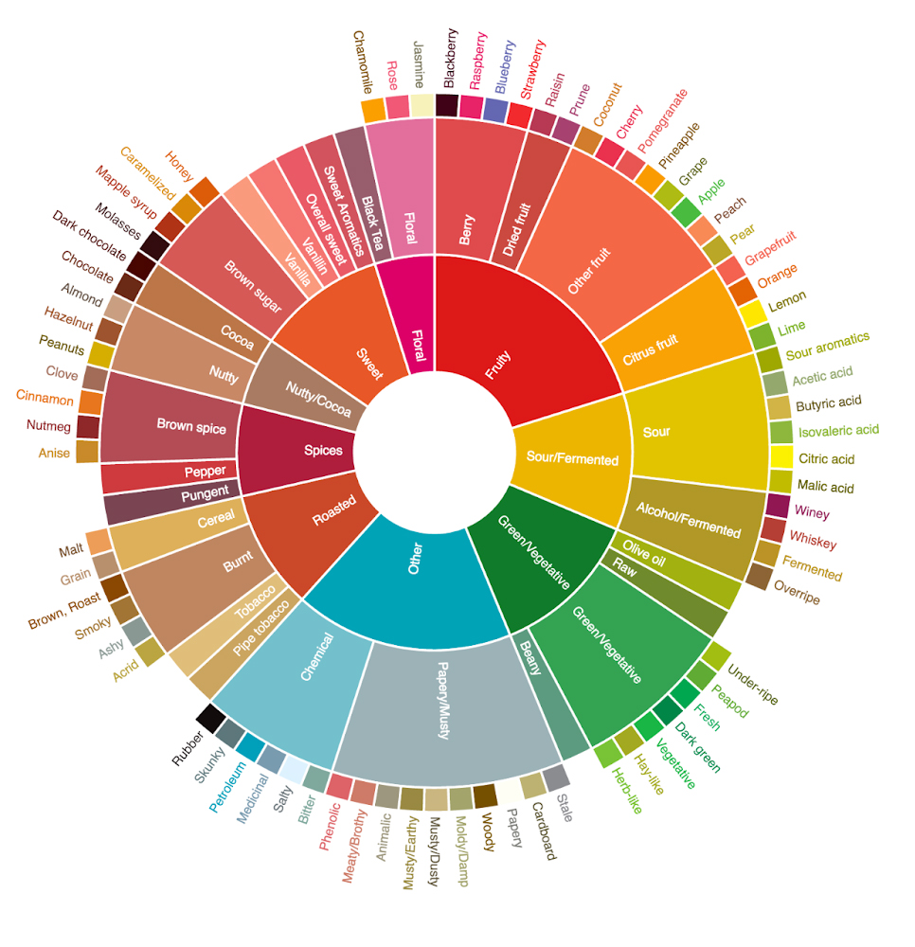
AI Flavor Profile
Flavor Profiles can provide new flavor combinations and surprises

Slide 7




Data Aggregator
Aggregate menus and catalogs from popular coffee shops, restaurants and grocery stores
Detailed Dietary Information (caffeine, calories, sugars, dairy)
Flavor Profile breakdowns of coffee drinks

Slide 8

Coffee Rewards (2025)
Rewards and discount platform for using Java Genie app
Customers earn Coffee Rewards for filling out surveys, writing reviews, and making in-app purchases with partners for discount pricing.
Reviews and feedback help improve the AI algorithm

Slide 9
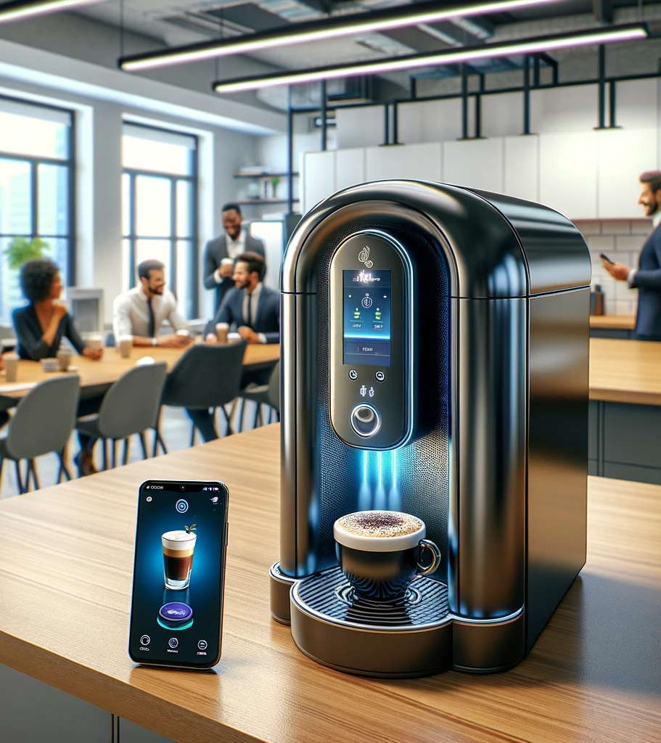
Java Genie Espresso Machine (Q1 2026)
All-in-one AI enhanced Espresso machine for home and small office.
Contains canister for 2 coffee beans and 5 flavors.
Retail Price: $2,000

Slide 10
Java Genie Vending Machine (Q4 2026)
All-in-one AI enhanced Espresso Vending Machine with larger capacity
6 coffee bean canisters
20 flavors
AI-automated
commercial industrial design
Retail Price with 36-month lease: $30,000

Slide 11

Maintenance Program
Maintenance program to fix and fine-tune Java Genie machines.
Espresso Machine program starting at $25 month.
Vending Machine program starting at $1,000 annual membership or $100 monthly fees.

Slide 12
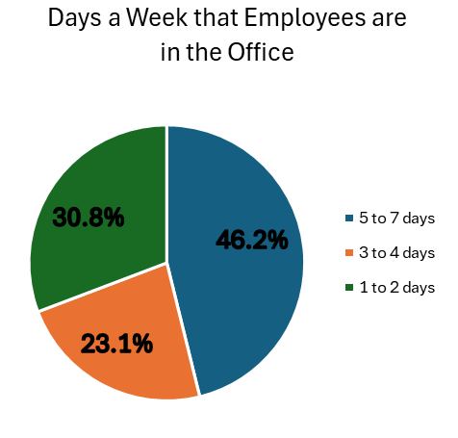
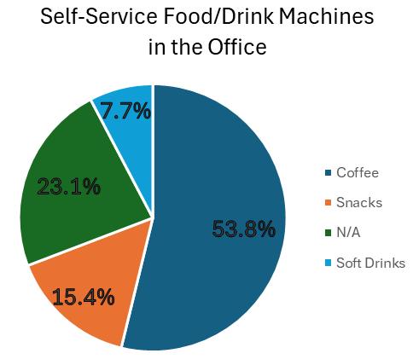
Interviews with 10 Business Owners

Slide 13

Customer and Target Market
Primary Customer Profile
Businesses with disposable revenue and a focus on employee satisfaction.
Decision makers: HR managers, office administrators, and business owners.
Target Market Composition
Includes corporate offices, small enterprises, and businesses prioritizing employee well-being.

Slide 14

Assumption: Benefits for Employers
Performance
The coffee machines in the office environment can greatly influence the employees' job performance [1]
Productivity
Employees' productivity can be supported by smart coffee machines [2]
Commitment
The coffee machines in the workplace have a positive impact on employees' commitment [3]
Reference:
[1] L. Larsen, et al., "Plants in the workplace: The effects of plant density on productivity, attitudes, and perceptions", 1998.
[2] L. Brugmans, et al., "The strategic value of smart work environment applications," The Leader: Corporate Real Estate & Workplace, 2017.
[3] E. Conway, and K. Monks, "Unravelling the complexities of high commitment: an employee-level analysis," Human Resource Management Journal, 2019.

Slide 15
Assumption: Benefits for Employees
Time
Employees can save time without going out and waiting in coffee shop lines [4]
Money
The cost of coffees from an office machine is always lower than that at the cafeteria [5]
Happiness
The coffee machine talks are one of the effective methods to raise the workplace happiness and emotional ties [6]
Reference:
[4] https://officeology.com/blog/benefits-having-office-coffee-machine/
[5] https://www.corpcofe.com/ways-your-office-coffee-machine-can-save-you-money/
[6] M. Mousa, H. K. Massoud, and R. M. Ayoubi, "Gender, diversity management perceptions, workplace happiness and organisational citizenship behaviour," Employee Relations: The International Journal, vol. 42, no. 6, pp. 1249-1269, 2020.

Slide 16
Revenue Model
Java Genie Vending Machine
Consumer Machine
~$820 /mo
Recurring Revenue
$2,000
Machine Purchase
84%
Gross Margin based on 36-month lease
15%
Gross Margin
Revenue-driver
Introduces Business Clients to Brand
Additional Recurring Revenue
Opt-in Maintenance Program
Coffee Rewards Program

Slide 17
Revenue Stream Breakdown
$4 M
$2,000 Price
FY 2025 Launch
Consumer Machine
Vending Machine
Maintenance Program
$10.5 M
$830 Lease
FY 2026 Launch
$14.6 M
Net Sales
FY2026
Flagship Product
$100 K
Both Product Lines
FY 2025 Launch
Amounts shown based on FY2026 Pro-forma projections

Slide 18
Net Income & Expenses
Amounts shown based on FY2026 Pro-forma projections
Top 10 Expenses account for 92% of all Expenses
Net Income $6.5 M 45% Net Margin
$14.6 M
Net Sales
FY2026
COGS $5.2 M
Expenses $2.8 M

Slide 19
Thank You!
Questions?

Slide 20
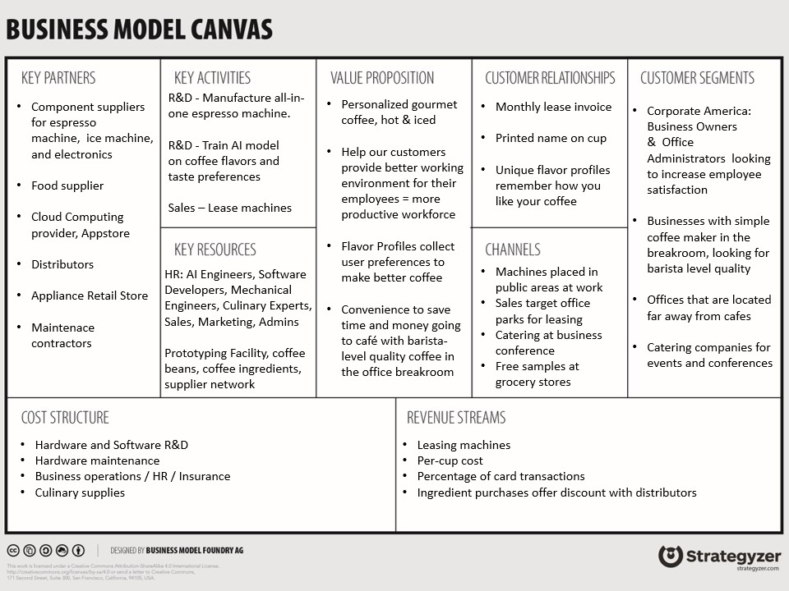

Slide 21
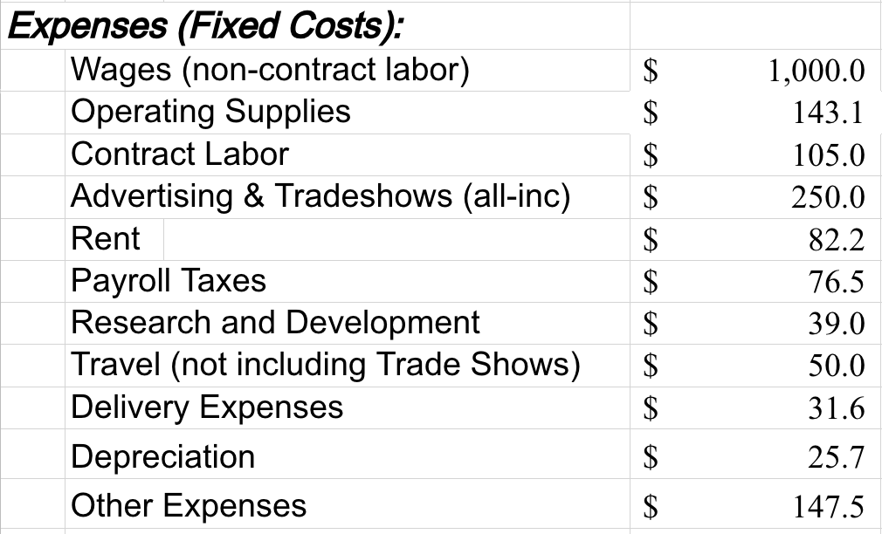
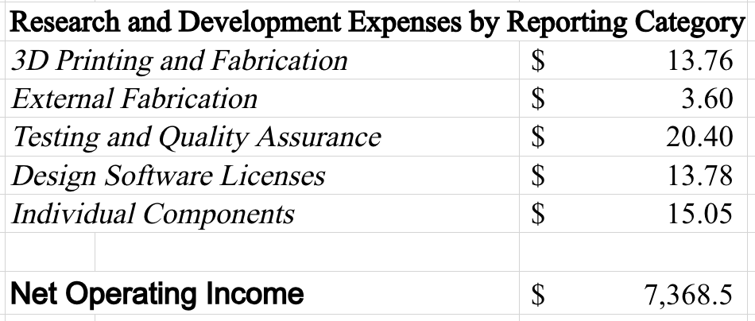
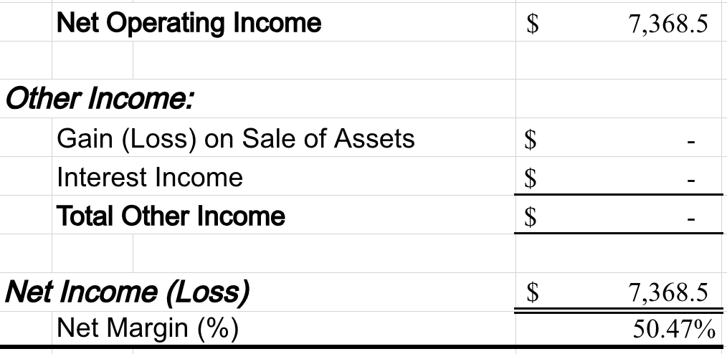
Expenses & Net Income
Amounts shown in thousands and based on FY2026 Pro-forma projections

Slide 22
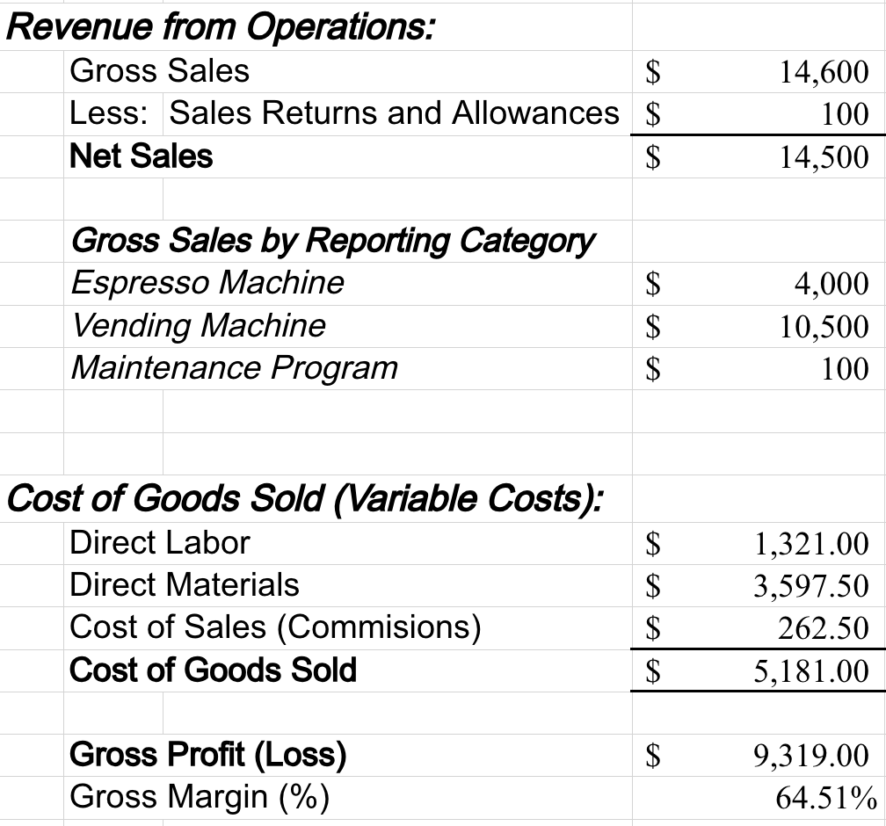
Revenue and Cost of Goods Sold
Amounts shown in thousands and based on FY2026 Pro-forma projections

